Slide 1
Global Electronics Retail
A data analysis of a fictional global electronic retailer’s datasets.
An analysis report by Ramogi Mukisa Lore, 188454

Slide 2
Introduction:
This presentation is a culmination of the various analytical and visualization skills acquired throughout the course. Including Data Manipulation using Pandas, Visualization using Seaborn, and Hypothesis Testing using Scipy.
It is a look at the records kept by a fictional global electronics retailer for various fields of interest. Including Sales, Products offered, Customer data and Currency Exchange Rates.
While being technical my objective is to give a glimpse of what I found upon analysing the dataset. Such that not only those with technical expertise can understand but a fictional stakeholder with little to none such expertise can as well.

Slide 3
Introduction: Motivation
Dataset used: Global Electronics Retailer free dataset
Reason for choice:
  I had decided for the capstone project to perform data analysis on multiple related datasets not too dissimilar to performing data analysis on a database. This was taken not only as a personal challenge but as practice for the collection of data analytical skills gained throughout the course.
  The dataset was sourced from an open source data collection from Maven analytics and was of both high quality and quantity with very few missing values. Perfect for analysis.
The description for the dataset from the source website reads:
  Sales data for a fictitious global electronics retailer, including tables containing information about transactions, products, customers, stores and currency exchange rates.
From the dataset this report will look into sales transactions analytics, products analytics, product delivery metrics and hypothesis testing.

Slide 4
Introduction: Descriptive Statistics
The dataset ‘Global Electronics Retailer’ contains 5 fictional relational tables that each contain data collected by a fictional global electronics retailer about several things.
Data_Dictionare.csv
  This is a table that acts as a dictionary that provides descriptions for all attributes of the other tables in the 'Global Electronics Retailer' folder.
  The table has 37 rows and 3 attributes, from which we can refer that there are a total of 37 attributes across the entire dataset split between the different tables.
Customers.csv
  A table that keeps customer details.
  It consists of 15,266 rows and 10 features.
Sales.csv
  A table that records all sales transactions between the retailer and customers.
  It consists of 62,884 rows and 9 attributes.
Exchange_Rates.csv
  A table that keeps records of different currencies and their exchange rates as compared to USD.
  The purpose of this table might be for tracking transactions in different currencies on different dates. E.g: calculating how much 1 product was sold for on 2/4/2016 in Canadian Dollars.
Products.csv
  A table that keeps records of different products offered for sale by the retailer.
  It is very detailed, having attributes for unit cost, unit price, category, sub-category, etc.
  It contains 2,517 rows and 10 attributes.

Slide 5
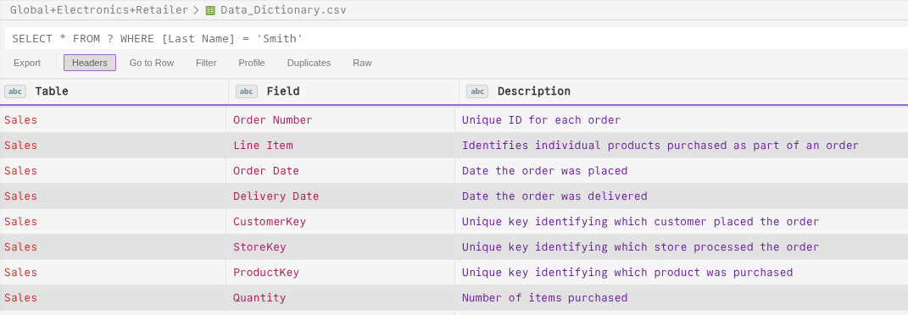
Introduction: Data_Dictionary.csv
Below is a small sample of the Data Dictionary table.
fig. 1: Screenshot of the first few rows of the Data_Dictionar.csv file to show how attributes of other tables are recorded.

Slide 6
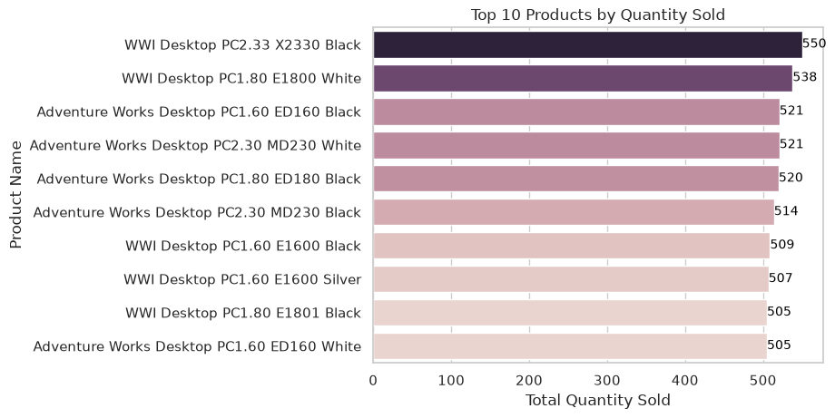
Data Analysis: Top 10 products analysis
The global retailer specialises in electronics, and according to the Products table they offer over 2,500 products.
The following barplot lists the top 10 products by quantity sold.
As can be seen all 10 of their top products have achieved over 500 units sold and come from the computers category. Showing that computers is the best performing category of products sold by the Retailer.
fig. 2: Visualization output of cell 50 of the Jupytr Notebookn showing a barplot of the Top 10 products by quantity sold.

Slide 7
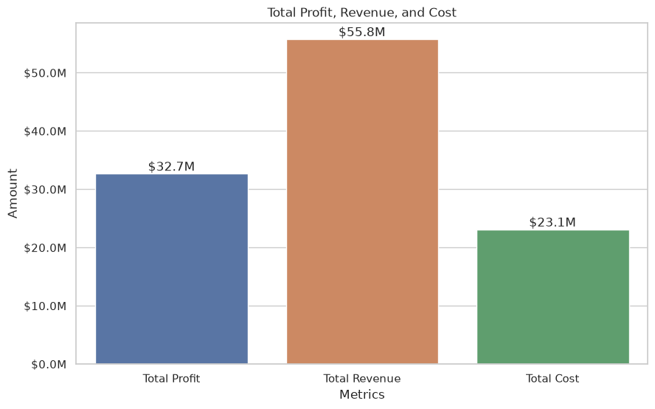
Data Analysis: Total Profits, Revenue and Cost
Upon further analysis of the retailer’s sales we are able to obtain their Total Revenue, cost and gross profits.
The bar-plot shows the totals in comparison to each other and we are able to infer that the retailer generated:
  Total revenue of $55,755,479.59
  Total Costs of $23,092,791.21
  And Total Profits of $32,662,688.38
From these totals we are able to obtain a gross profit margin using the formula (Total Profit/Total Revenue)x100%.
What we obtain is a gross profit margin of 58.58% which shows that the retailer is extremely profitable as a business.
fig. 3: Visualization output of cell 54 of the Jupytr Notebookn showing a barplot of the Total Profit, Revenue, and Cost metrics.

Slide 8

Data Analysis: Analysis of Deliveries
In the sales table, there are attributes for both 'Order Date' and 'Delivery Date'.
These attributes can help us analyse delivery times for each sale of a product.
The objective was to use deliveries to find out what percentage of sales required deliveries and make inferences from the result.
From the figure we can note that in-store purchases make up 79.06% of all sales while the rest required deliveries to customers.
This can show that the majority of customers purchase products of sufficient size to not require deliveries.
It can also imply, however, that a minority of customers make order from different geographical locations to the store they purchase the product from.
Further analysis of distance between customers and stores might be able to make this more clear.
fig. 4: Output of cell 59 of the Jupytr Notebook showing delivery metrics.
Note: In-store purchases refers to Sales where the ‘Delivery Date’ attribute is blank while Purchases requiring deliveries refers to Sales where the ‘Delivery Date’ has a date value.

Slide 9
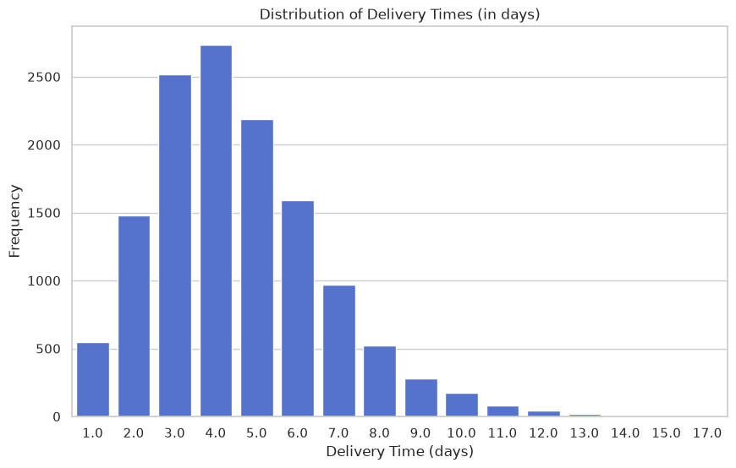
Data Analysis: Distribution of Delivery Times
Purchases requiring deliveries form a minority of total sales. However, from that minority we are able to infer some insights on the retailer’s logistic network.
The following countplot shows that when we plot delivery times we obtain a distribution that is positively skewed with a range of delivery times from 1 to 17 days and high concentration of delivery times taking 3 to 5 days.
fig. 5: Output of cell 63 of the Jupytr Notebook showing distribution of delivery times (in days).

Slide 10
Statistical Analysis: Hypothesis Testing
I also wished to test a few hypotheses made about the various datasets.
I wished to test:
  If there was any statistically significant difference between online and in-store order values.
  If there was any statistically significant difference in purchase quantities among categories
Test 1: Two-Sample t-Test (Online vs. In-Store Spending)
Test 2: One-Way ANOVA (Order Quantities Across Product Categories)
Using Welch’s t-test I was able to test for any significant difference between the average online spend and average Store-order spend.
Our hypothesis statements are as follows:
  H0: There is no statistically significant difference between online and in-store order spending.
  Ha: There is a statistically significant difference between online and in-store order values
fig.6 on the next slide shows that upon testing we fail to reject H0. Proving that customers exhibit equivalent spending power regardless of the channel they purchase products from. Showing consistent customer intent across all platforms.
Running One-Way ANOVA I was able to test for any significant difference in the order quantities between different categories.
Our hypothesis statements are as follows:
  H0: There is no statistically significant difference in purchase quantities among categories
  Ha: There is a statistically significant difference in purchase quantities among categories
fig. 7 on the next slide shows that upon testing we fail to reject H0. Proving that customers show no favour towards any particular category of products.

Slide 11
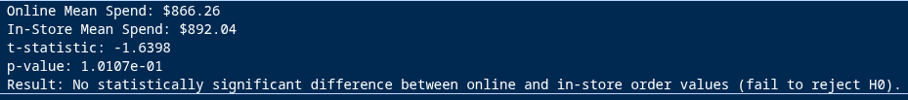
Statistical Analysis: Hypothesis Testing
fig. 6: Output of cell 66 of the Jupytr Notebook showing the results of Welch’s t-test.
fig. 7: Output of cell 68 of the Jupytr Notebook showing the results of One-Way ANOVA.

Slide 12
Conclusions
1. Financial Overview and Margins
  Exceptional Gross Profit:
    Across all sale transactions, the business realized a gross profit margin of 58.58% (approximately $32.7M profit on $55.8M gross revenue.)
  Margin Scope:
    This reflects pure gross product markup (Unit Price - Unit Cost) before operating overhead costs (store leases, fulfillment logistics, sales labor, etc).
2. Core Revenue Drivers
  Flagship Profit Engines:
    The ‘WWI Desktop PC2.33 X2330 Black’ is the single most valuable item, generating $505,450.00 in revenue and $337,986.00 in gross profit alone. (Please refer to the output of cell 48 of the Jupytr Notebook for reference)
  Top 10 Consistency:
    The top 10 products by quantity sold belong to either the ‘WWI Desktop PC’ or ‘Adventure Works Desktop PC’ product lines. Showing that the customer base highly favour the retailer's desktop products.
3. Delivery Distributions
  Fulfillment Segmentation:
    In-store purchases account for 79.06% of all transactions (49,719 orders), which are fulfilled immediately in-store.
  Right-Skewed Online Fulfillment:
    Among the remaining 13,165 delivered orders, shipping durations range from 1 to 17 days, with an average duration of 4.5 days (Please refer to the output of cell 61 of the Jupytr Notebook for reference) and a large concentration of orders fullfilled within 3 to 5 days.
  The "Long Tail" Bottleneck:
    The distribution displays a pronounced positive skewness. While the majority of packages arrive within 5 business days, an extended right tail stretching up to 17 days shows that the logistical network has some inefficiency.

Slide 13
Conclusions
4. Statistical Inference
  2 sample hypothesis testing results:
    Welch’s two-sample t-test evaluated order spend between online and in-store purchases:
      In-Store Mean Spend: $892.04
      Online Mean Spend: $866.26
      t-statistic = 1.6398
      p-value = 0.10107
    Because p > 0.05, we fail to reject the null hypothesis H0. There is no statistically significant difference in average spend across physical stores and the digital store. Customers exhibit equivalent spending power regardless of the purchase channel, indicating consistent customer intent across platforms.
  One-way ANOVA hypothesis testing results:
    One-way ANOVA evaluated order quantities across product categories:
      F-statistic: 1.3247
      p-value = 0.23367
    Because p > 0.05, we fail to reject the null hypothesis H0. There is no statistically significant difference in order quantities across the different product categories. Customers show no significant favour towards any particular category indicating consistent customer consumption across product categories.
END

Slide 14
References
Websites and articles:
Global Electronics Retailer - Dataset used
Perform a Sample T-Test in Python - Guide on how to perform a 2 sample t-test (Section: "Perform a Two-Sample T-Test in Python")
How to format axis-tick-label from number to thousands or Millions (125,436 to 125.4k) - Stack Overflow forum on how to format axis tick labels
Python packages used:
Pandas
  For creating dataframes and data manipulation
Matplotlib
  For seaborn visualization formatting
Seaborn
  For visualization outputs
scipy
  For hypothesis testing

Slide 15
Thank You
Are there any Questions
Ramogi Mukisa Lore
188454

